Slide 1

3. Statistical Inference

Slide 2
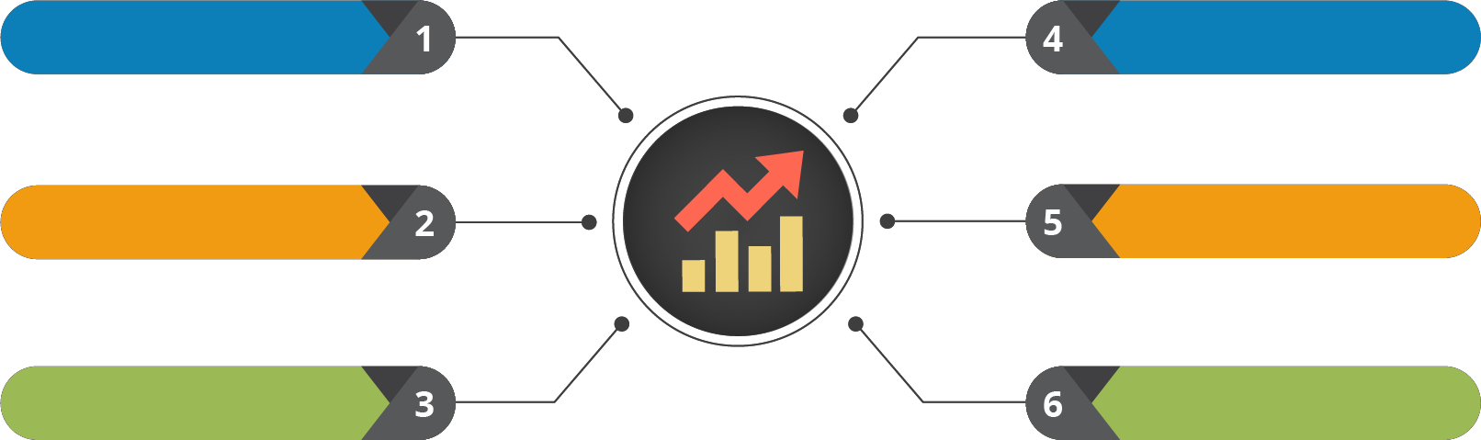


Course Outline
Understanding the Data
Testing the Data
Probability and its Uses
Data Clustering
Statistical Inference
Regression Modelling

Slide 3

Course Objectives
After completing this module, you should be able to:
Illustrate Point Estimation
Demonstrate the use of Level of Confidence and Confidence Margin
Draw meaningful inferences using Margin of Error
Explain Hypothesis Testing
Explore the different levels of Hypothesis Testing

Slide 4


1. Point Estimation

Slide 5
Point Estimation

Slide 6


What is Point Estimation?
In simple terms, any statistic can
be a point estimate
02
01
For eg: Sample standard deviation (s) is a point estimate of the population standard
deviation (σ)
Technically, a point estimator is any function W (𝑥₁,……,𝑥₂) of a sample
03

Slide 7


Why Point Estimation?
Population
Sample
Random
𝜇
Mean of Population
Estimate
𝑥ҧ
Sample Mean

Slide 8


Point Estimation Terminologies
Estimate
Realised value of estimator
Estimator
f (x) of sample

Slide 9

Finding the Estimates
Method of Moments
Estimates are found out by equating the first k sample moments to the corresponding k population moments.
Maximum of Likelihood
Uses a model and uses the values in the model to maximize a likelihood function. This results in the most likely parameter for the inputs selected.
Baye’s Estimators
Minimizes the average risk (an expectation of random variables).
Best Unbiased Estimators
Several unbiased estimators can be used to approximate a parameter (which one is “best” depends on what parameter you are trying to find).
Methods

Slide 10
Demo: Point Estimates

Slide 11







Tasks To Do
Consider you have a data of U.S. voters
Goal: Find average age of registered voters in the US
Step 01: Generate a population of random age data and calculate the average
Step 02: Draw a sample of respondents from it
Step 03: Calculate average age of the respondents as a point estimate of the average age of the population
Step 04: Draw an inference based on the difference between sample mean and population mean

Slide 12


Step 01
Generate a population of random age data and calculate the average
%matplotlib inline import numpy as np import pandas as pd
import scipy.stats as stats import matplotlib.pyplot as plt import random
import math
np.random.seed(10)
population_ages1 = stats.poisson.rvs(loc=18, mu=35, size=150000) population_ages2 = stats.poisson.rvs(loc=18, mu=10, size=100000) population_ages = np.concatenate((population_ages1, population_ages2))
population_ages.mean()
Output: 43.0023720000

Slide 13
Step 02
Draw a sample of respondents from it
np.random.seed(6)
sample_ages = np.random.choice(a= population_ages,size=500)

Slide 14


Step 03
Calculate average age of the respondents as a point estimate of the average age of the population
print ( sample_ages.mean() )
Output: 42.388

Slide 15


Step 04
Draw an inference based on the difference between sample mean and population mean
population_ages.mean() - sample_ages.mean()
Output: 0.61437200000000303

Slide 16
2. Level of Confidence &
Confidence Margin

Slide 17
Level of Confidence & Confidence Margin

Slide 18


There are two most important stats to determine, how well the point estimates generalise the entire population.
Let’s explore them too

Slide 19


Interval Estimate
Generalizing Point Estimates
An Interval, or range of values, used to estimate a population parameter
Point Estimate
1 Interval Estimate
2
Margin of Error
Lower Confidence
Limit
Upper Confidence Limit
Interval Estimate

Slide 20




Confidence Intervals
Confidence Intervals is the measure of your confidence, that the interval estimate contains the population mean, 𝜇
01
Statisticians use a confidence interval to describe the amount of uncertainty associated with a sample estimate of a population parameter
02
Technically, a range of values so constructed that there is a specified probability of including the true value of a parameter within it
03

Slide 21




Margin of Error
Generalizing Point Estimates
Difference between the point estimate and the actual population parameter value is called the Sampling Error.
When 𝜇 is estimated, the sampling error is the difference 𝜇 - 𝑥ҧ
1 Confidence Interval
2
Margin of Error
Margin of Error E, for a given level of confidence is the greatest possible distance between the point estimate and the value of the parameter it is estimating
_{𝑍} 𝜎
E =
𝑐
𝑛

Slide 22

Let’s discuss on how to estimate these confidence intervals?

Slide 23
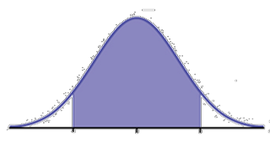
Estimating Level of Confidence
The level of confidence c is the probability that the interval estimate contains the population parameter.
1
(1 - c)
2
C
¹ (1 - c)
2
- 𝑍_{𝑐}
Z = 0
𝑍_{𝑐}
Critical Values
C is the area beneath the normal curve between the critical values Corresponding Z score can be found out using the standard normal table

Slide 24
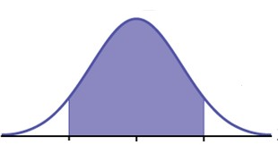
Common Levels of Confidence
If the level of confidence is 90%, this means that you are 90% confident that the interval contains the population mean, 𝜇.
0.90
0.05
0.05
- 𝑍_{𝑐} = 1.645 Z = 0
𝑍_{𝑐} = 1.645
The Corresponding Z – scores are ± 1.645

Slide 25
Margin of Error – Problem Statement
A random sample of 32 textbook prices is taken from a local college bookstore. The mean of the sample is 𝑥ҧ
= 74.22, and the sample standard deviation is S = 23.44. Use a 95% confidence level and find the margin of
error for the mean price of all textbooks in the bookstore.

Slide 26

Margin of Error – Solution
You know by formula, E = 𝑍_{𝑐} ^{𝜎}
𝑛
= 1.96 * (23.44/ 32) ≈ 8.12
We are 95% confident that the margin of error for the population mean (all the textbooks in
the bookstore) is about $8.12

Slide 27
Construction of a Confidence Interval
Identify a sample statistic
Choose the statistic that you will use to estimate a population parameter.
Find the Margin of Error Find the margin of error based on the previous
equation explained.
1
3
Select a Confidence Level As, the confidence level describes the uncertainty
of a sampling method.
Specify the Confidence Interval
The Confidence Interval can be found out by: Confidence Interval =
Sample Statistic ±
Margin of Error.
2
4

Slide 28
Demo: Confidence Intervals & Margin of Error

Slide 29

Scenario
#3
You can feel free to assume a 95% confidence Interval
#1
You are having an estimate of mean point estimate
#2
Point estimate is to be generalised over the entire population

Slide 30







Tasks To Do
Consider the sample mean for population_ages
Calculate z* value for a 95%
confidence interval
Using z* value, estimate the margin of error
Find the confidence interval

Slide 31
Solution
np.random.seed(10)
sample_size = 1000
sample = np.random.choice(a= population_ages, size = sample_size) sample_mean = sample.mean()
z_critical = stats.norm.ppf(q = 0.975) print("z-critical value:") print(z_critical)
# Get the z-critical value* # Check the z-critical value
pop_stdev = population_ages.std() # Get the population standard deviation margin_of_error = z_critical * (pop_stdev/math.sqrt(sample_size)) confidence_interval = (sample_mean - margin_of_error,
sample_mean + margin_of_error)
print("Confidence interval:")
print(confidence_interval)

Slide 32


Solution – Output
Note that the confidence interval you calculated captures the true population mean of 43.0023

Slide 33







Two Samples Confidence Interval
Two samples confidence interval is calculated when you need to compare between two independent groups
You can start by computing the sample sizes (n1 and n2), means (x1 and x2) and standard deviations (s1 and s2) in each sample
Steps to be performed, while applying two samples confidence interval
Parameter of interest = 𝜇₁ - 𝜇₂, difference in the
population means
Point Estimate = 𝑥₁ - 𝑥₂
The confidence interval will be computed using either the z or t distribution for the selected confidence level and the standard error of the point estimate

Slide 34
3. Hypothesis Testing

Slide 35
Hypothesis Testing

Slide 36

Let’s understand another leaf (Hypothesis Testing) in the branch of Inferential Statistics

Slide 37



Hypothesis Testing – Scenario
I believe the mean population age is 50

Slide 38


Hypothesis Testing – Scenario (Contd…)
Sampling
I think the total population mean is somewhat > 50
Sample Mean = 20

Slide 39





Components of Hypothesis Testing
Null Hypothesis, 𝑯_{𝟎}
Alternative Hypothesis, 𝑯_{𝒂}
States the hypothesized value of the parameter
before sampling
All possible alternatives, other than null hypothesis
Example: 𝜇 ≠ 20, 𝜇 > 20, 𝜇
< 20
The assumption we wish to test (or the assumption
we are trying to reject)

Slide 40




Hypothesis Testing – Process Flow
Hypothesis testing refers to: making an assumption, called hypothesis
Collecting sample data
Calculating a sample statistic
Flowchart
Using the sample statistic to evaluate the hypothesis
In a nutshell, it’s a claim what you want to test

Slide 41
Before, we start with Hypothesis Testing,
let’s understand a few technicalities associated with it

Slide 42





Significance & Confidence Levels
Significance level is the probability of rejecting the null hypothesis when it is true, which is known as Type I error
The Confidence level is just the compliment of Significance level which signifies how confident you are in your decision
01
01
Denoted by 𝛼
02
02
Expressed as: 1 - 𝛼
Note: The significant and confidence levels always add to 1

Slide 43
Interpreting Significance Levels
01
Deciding on a criterion for accepting or rejecting the null hypothesis
02
Refers to the percentage of sample means that is outside certain
prescribed limits
03
Higher the level of significance, higher is the probability of rejecting the null hypothesis when it is true

Slide 44
Interpreting Significance Levels – Example
Consider testing a hypothesis at 5% level of significance:
Reject the null hypothesis if it falls in the two regions of area 0.025
Do not reject the null hypothesis if it falls within the region of area 0.95

Slide 45
Computing the Significance Level
Two ways the significance level can be calculated:
1.
One Tail Test
2.
Two Tail Test

Slide 46
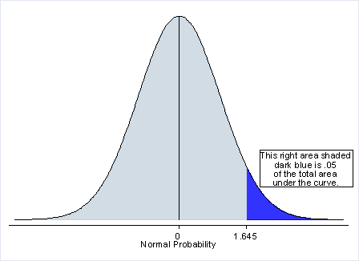
One Tail Test
A One-Tail test is a statistical hypothesis test in which the values for which we can reject the null hypothesis, H₀ are located entirely in one tail of the probability distribution

Slide 47
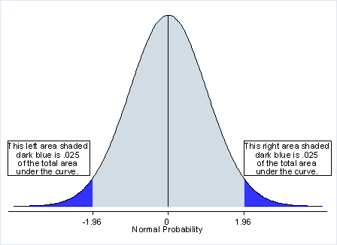

Two Tail Test
Two Tailed test will reject the null hypothesis if the sample mean is significantly higher or lower than the hypothesized mean
Appropriate when H₀ : µ = µ₀ and H_{A}: µ ≠ µ₀

Slide 48
There are different modes of testing, as one tailed test and two tailed test. We’ll discuss them in next module

Slide 49

Summary
In this module, you should have learnt:
Illustrate Point Estimation
Demonstrate the use of Level of Confidence and Confidence Margin
Draw meaningful inferences using Margin of Error
Explain Hypothesis Testing
Explore the different levels of Hypothesis Testing

Slide 50


Congratulation
Probability & Statistics
for Data Science
You have successfully completed –
Statistical Inference Data Session

Slide 51





Next Topic, We will see the
Testing the Data
Okay, I clearly understand the Statistical Interference
What Next?

Slide 52



Slide 53


Slide 54


Slide 55


